Slide 1
Fundamentals of Computer Vision and its Applications
Course Code and Name: UCS655 - AI Applications

Slide 2
Fundamentals of Computer Vision and its applications:
Introduction and goal of computer vision
Basics of image processing and formation
Convolutional neural network
Use cases: Face Recognition, Self-Driving Cars, Video Surveillance for Traffic

Slide 3
Introduction and goal of computer vision

Slide 4
What is Computer Vision?
Computer vision is a field of study focused on the problem of helping computers to see.
At an abstract level, the goal of computer vision problems is to use the observed image data to infer something about the world.
— Page 83, Computer Vision: Models, Learning, and Inference, 2012.

Slide 5
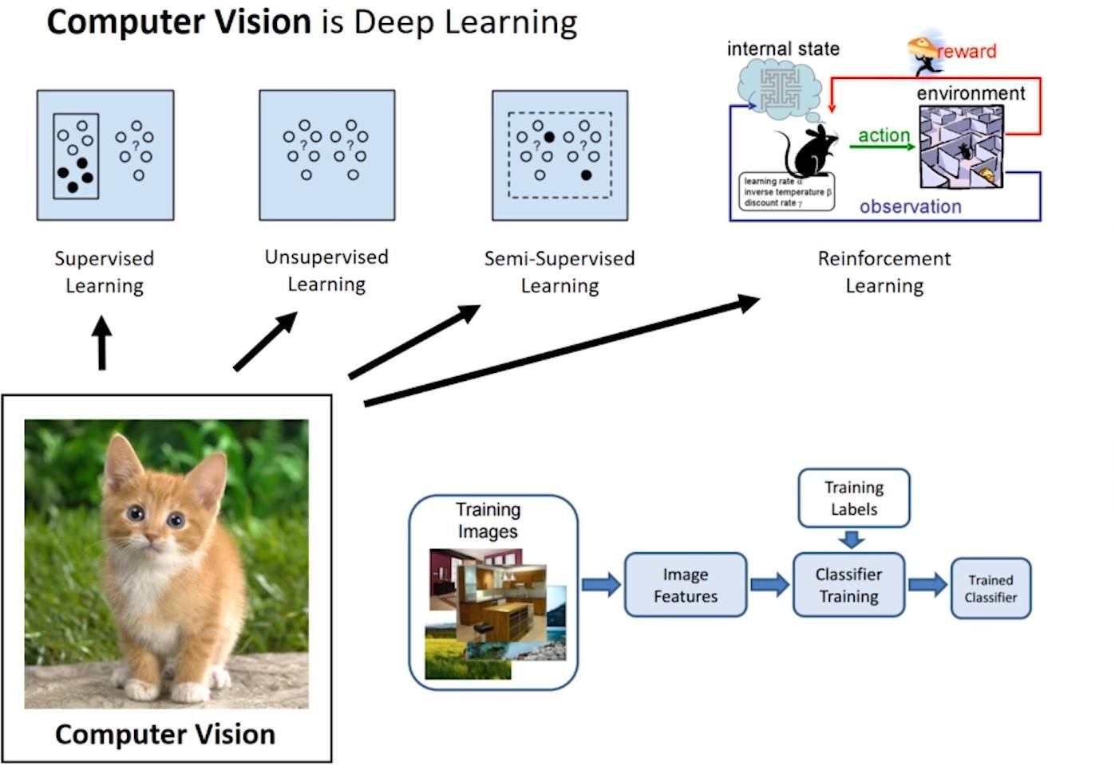

Slide 6
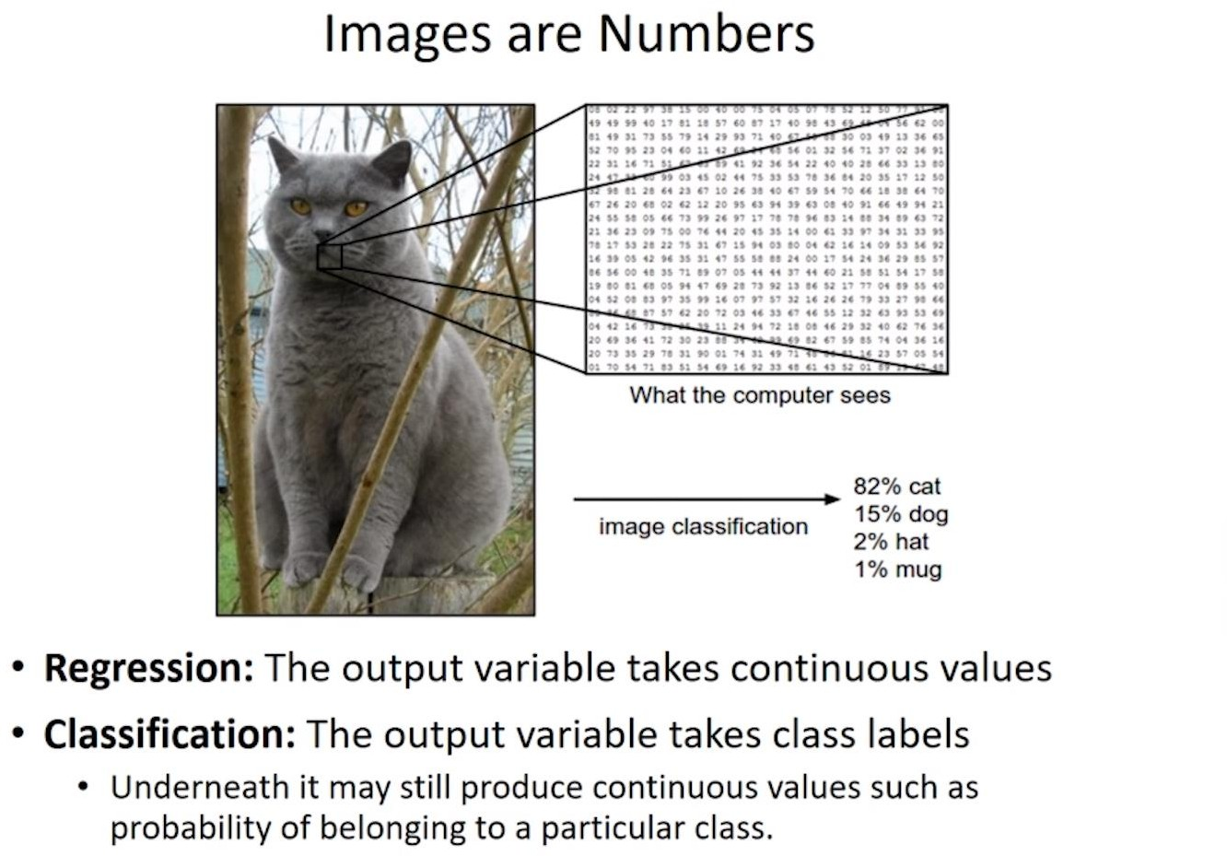
What includes Computer Vision?
Images
2D images are made up of pixels.
3D images are built using voxels, meshes, point-clouds and RGB-D images.
Videos
Frames per second (FPS) based images

Slide 7
What does not include Computer Vision?
Text Data – Natural Language Processing
Audio Data – Computer Audition or Machine Listening

Slide 8
Areas of Computer Vision
Image Classification
Image Localization
Object Detection
Semantic Segmentation
Instance Segmentation
Image Generation
Pose Estimation
Domain Adaptation
Autonomous Vehicles
Activity Recognition
Depth Estimation
Few Shot Learning
Anomaly Detection
Image Reconstruction
Image Captioning
Visual Question Answering
Gesture Recognition

Slide 9
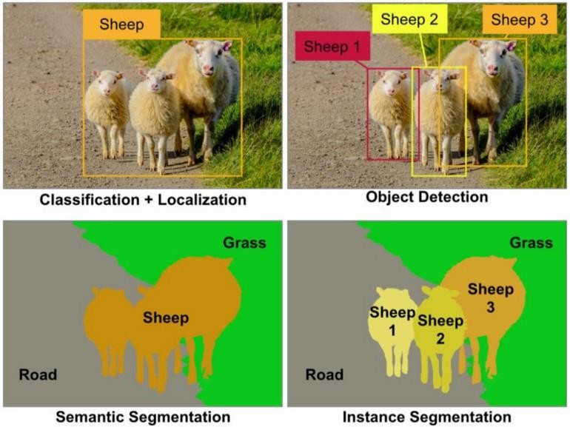
Areas of Computer Vision
Image Classification
Image Localization
Object Detection
Semantic Segmentation
Instance Segmentation
Image Generation
Pose Estimation
Domain Adaptation
Autonomous Vehicles
Activity Recognition
Depth Estimation
Few Shot Learning
Anomaly Detection
Image Reconstruction
Image Captioning
Visual Question Answering
Gesture Recognition
Detection and Segmentation through ConvNets | by Ravindra Parmar
| Towards Data Science

Slide 10
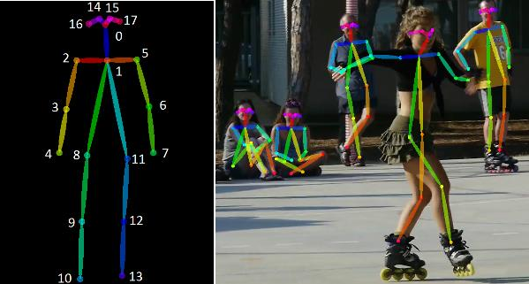
Areas of Computer Vision
Image Classification
Image Localization
Object Detection
Semantic Segmentation
Instance Segmentation
Image Generation
Pose Estimation
Domain Adaptation
Autonomous Vehicles
Activity Recognition
Depth Estimation
Few Shot Learning
Anomaly Detection
Image Reconstruction
Image Captioning
Visual Question Answering
Gesture Recognition
Skating
An Overview of Human Pose Estimation with Deep Learning | by Bharath Raj | BeyondMinds | Medium

Slide 11
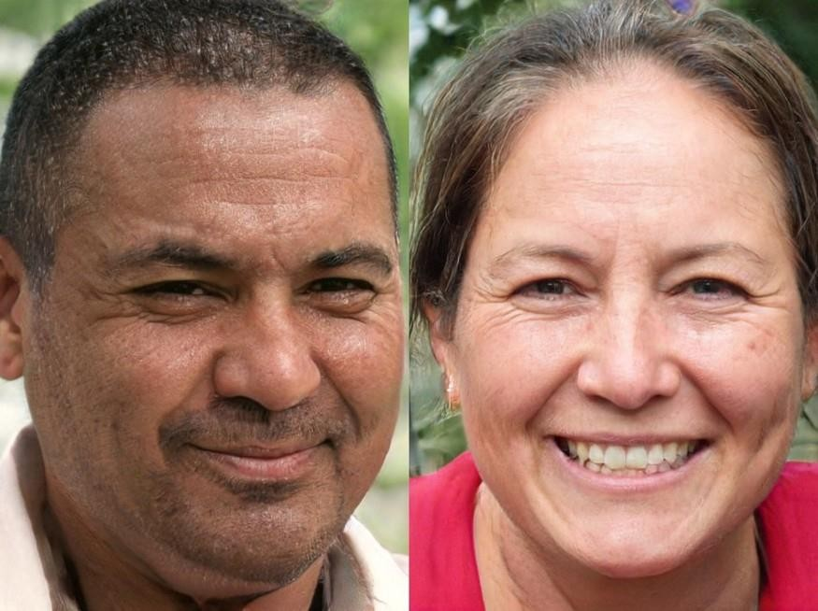
Areas of Computer Vision
Image Classification
Image Localization
Object Detection
Semantic Segmentation
Instance Segmentation
Image Generation
Pose Estimation
Domain Adaptation
Autonomous Vehicles
Activity Recognition
Depth Estimation
Few Shot Learning
Anomaly Detection
Image Reconstruction
Image Captioning
Visual Question Answering
Gesture Recognition
GAN 2.0: NVIDIA’s Hyperrealistic Face Generator | by Synced |
SyncedReview | Medium

Slide 12
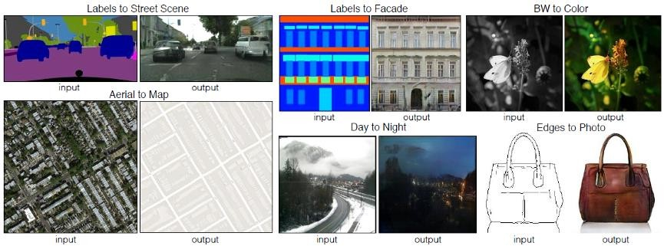
Areas of Computer Vision
Image Classification
Image Localization
Object Detection
Semantic Segmentation
Instance Segmentation
Image Generation
Pose Estimation
Domain Adaptation
Autonomous Vehicles
Activity Recognition
Depth Estimation
Few Shot Learning
Anomaly Detection
Image Reconstruction
Image Captioning
Visual Question Answering
Gesture Recognition
Domain Adaptation is the problem in which the task space is the same
and the difference is solely in input domain divergence.
Deep Domain Adaptation In Computer Vision | by Branislav Holländer | Towards Data Science

Slide 13
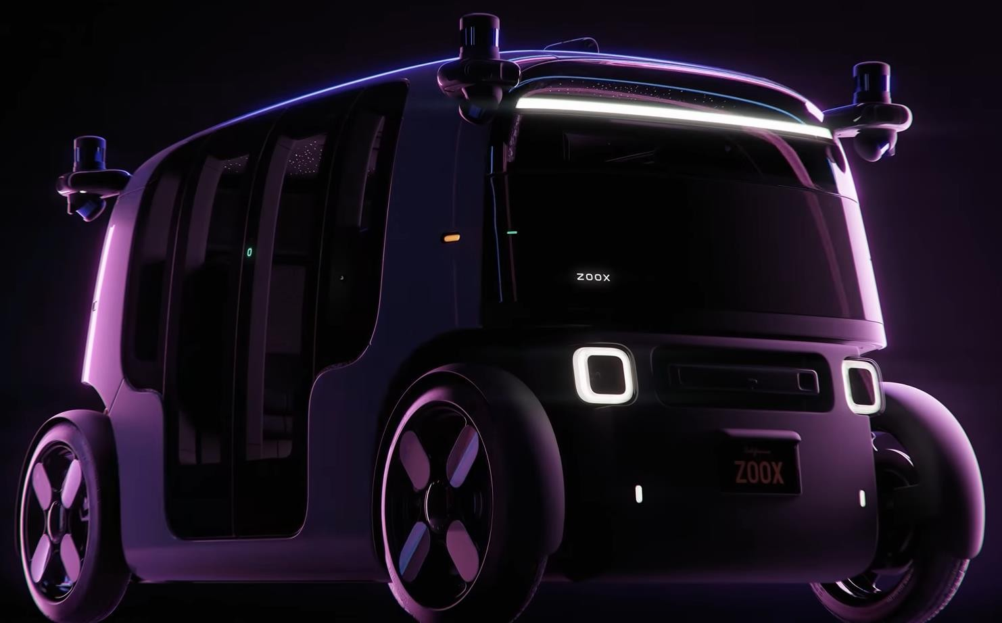
Areas of Computer Vision
Image Classification
Image Localization
Object Detection
Semantic Segmentation
Instance Segmentation
Image Generation
Pose Estimation
Domain Adaptation
Autonomous Vehicles
Activity Recognition
Depth Estimation
Few Shot Learning
Anomaly Detection
Image Reconstruction
Image Captioning
Visual Question Answering
Gesture Recognition
Fully Autonomous, All-Electric and Built for Riders, Not Drivers—This is Zoox - YouTube

Slide 14
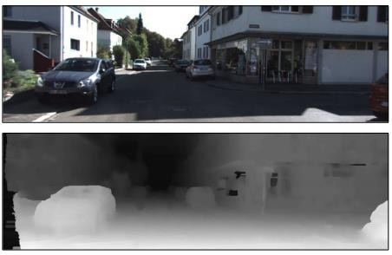
Areas of Computer Vision
Image Classification
Image Localization
Object Detection
Semantic Segmentation
Instance Segmentation
Image Generation
Pose Estimation
Domain Adaptation
Autonomous Vehicles
Activity Recognition
Depth Estimation
Few Shot Learning
Anomaly Detection
Image Reconstruction
Image Captioning
Visual Question Answering
Gesture Recognition
Depth Estimation: Basics and Intuition | by Daryl Tan | Towards
Data Science

Slide 15
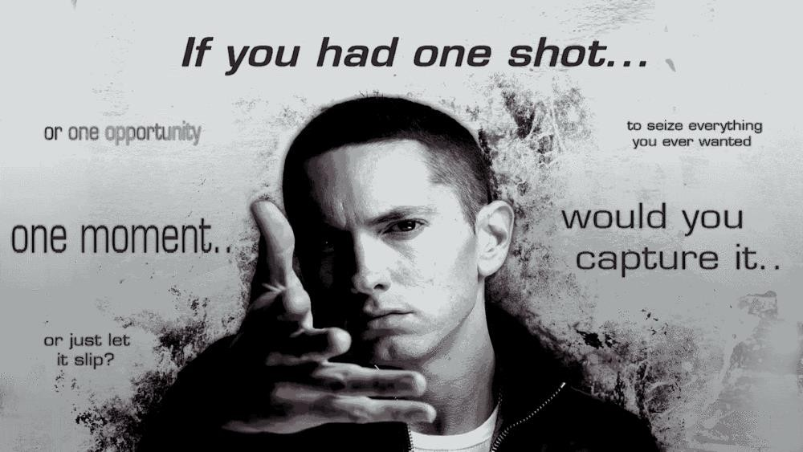
Areas of Computer Vision
Image Classification
Image Localization
Object Detection
Semantic Segmentation
Instance Segmentation
Image Generation
Pose Estimation
Domain Adaptation
Autonomous Vehicles
Activity Recognition
Depth Estimation
Few Shot Learning
Anomaly Detection
Image Reconstruction
Image Captioning
Visual Question Answering
Gesture Recognition
N-Shot Learning: Learning More with Less Data (floydhub.com)

Slide 16
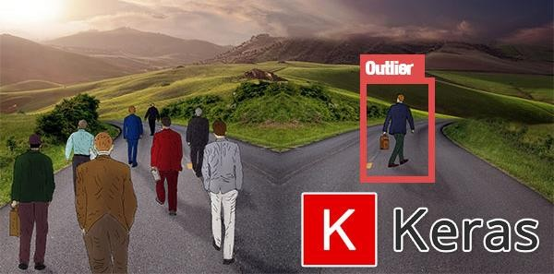
Areas of Computer Vision
Image Classification
Image Localization
Object Detection
Semantic Segmentation
Instance Segmentation
Image Generation
Pose Estimation
Domain Adaptation
Autonomous Vehicles
Activity Recognition
Depth Estimation
Few Shot Learning
Anomaly Detection
Image Reconstruction
Image Captioning
Visual Question Answering
Gesture Recognition
Anomaly detection with Keras, TensorFlow, and Deep Learning - PyImageSearch

Slide 17
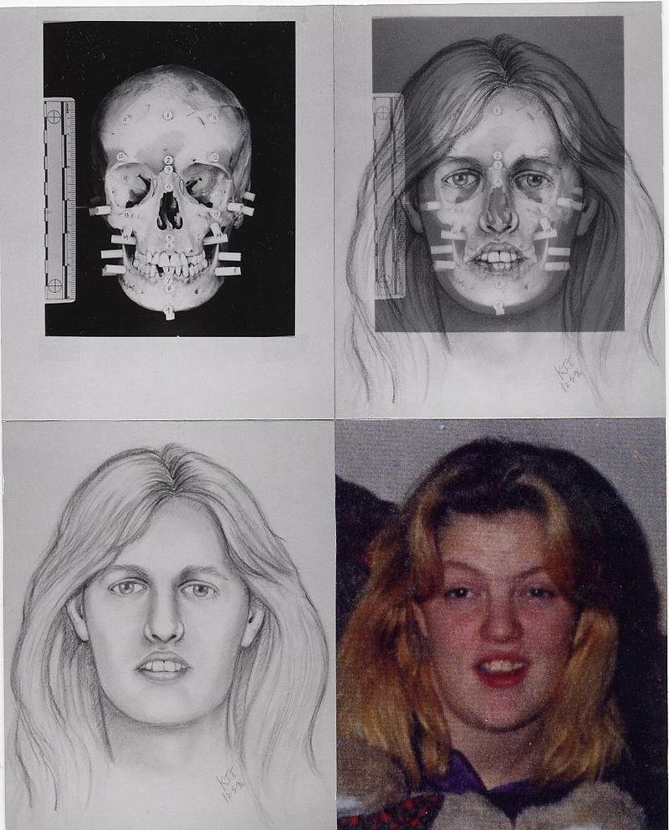
Areas of Computer Vision
Image Classification
Image Localization
Object Detection
Semantic Segmentation
Instance Segmentation
Image Generation
Pose Estimation
Domain Adaptation
Autonomous Vehicles
Activity Recognition
Depth Estimation
Few Shot Learning
Anomaly Detection
Image Reconstruction
Image Captioning
Visual Question Answering
Gesture Recognition
Forensic facial reconstruction - Wikipedia

Slide 18
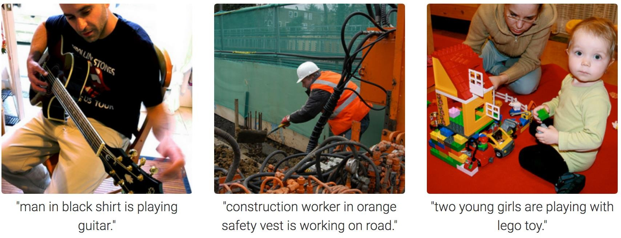
Areas of Computer Vision
Image Classification
Image Localization
Object Detection
Semantic Segmentation
Instance Segmentation
Image Generation
Pose Estimation
Domain Adaptation
Autonomous Vehicles
Activity Recognition
Depth Estimation
Few Shot Learning
Anomaly Detection
Image Reconstruction
Image Captioning
Visual Question Answering
Gesture Recognition
Image Captioning in Deep Learning | by Pranoy Radhakrishnan | Towards Data Science

Slide 19
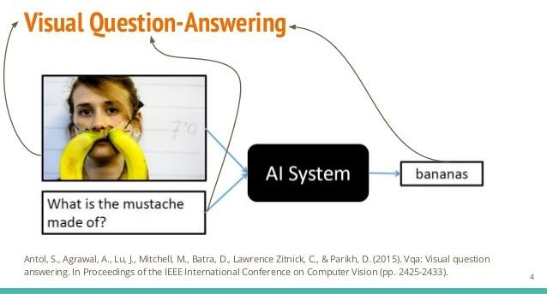
Areas of Computer Vision
Image Classification
Image Localization
Object Detection
Semantic Segmentation
Instance Segmentation
Image Generation
Pose Estimation
Domain Adaptation
Autonomous Vehicles
Activity Recognition
Depth Estimation
Few Shot Learning
Anomaly Detection
Image Reconstruction
Image Captioning
Visual Question Answering
Gesture Recognition

Slide 20
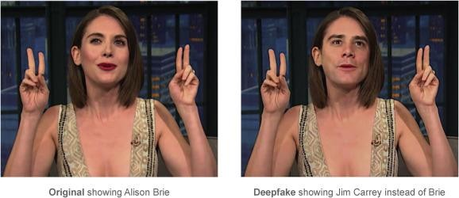
Where is CV right now?
Source: https://www.sciencedirect.com/science/article/abs/pii/S0007681319301600

Slide 21
Goals of Computer Vision
Typical goals of computer vision include:
The detection, segmentation, localisation, and recognition of certain objects in images (e.g., human faces)
The evaluation of results (e.g., segmentation, registration)
Registration of different views of the same scene or object
Tracking an object through an image sequence
Mapping a scene to a three-dimensional model of the scene; such a model might be used by a robot to navigate the imaged scene
Estimation of the three-dimensional pose of humans and their limbs
Searching for digital images by their content (content-based image retrieval)

Slide 22
Thanks!

